Slide 1
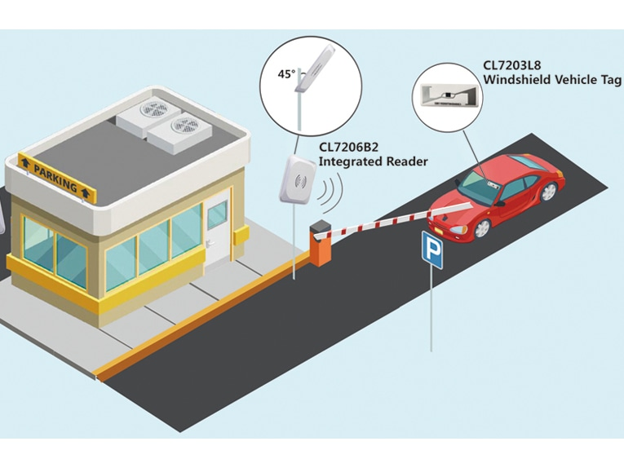
Automated vehicle access control system using
RFID and IoT
Felix Mayhua, Aldo José Gamarra Ancco, Elvis Cristhian
Diaz Huaringa, Alexis Abelardo Advisor: Oliden Martinez, José

Slide 2
1.Introduction
The current parking management systems need human resources for controlling access and recording the entries and exits which can lead to many errors such as unauthorized users access, public security, fraud to pay parking fees, etc.
We propose an automated access control system using RFID technology, PIC16F877A and ESP32.

Slide 3

2. Problematic
Parking and access systems management
Nowadays, the smart cities have proposed an effective and optimized parking systems that manage vehicle traffic that are being implemented all over the world.
The lack of an automatic vehicle access control system in the UNI, this system must be safe, cheap and have to be able to make easier the entry for all UNI members that use vehicles.

Slide 4
3. Goals
Smart City
Improve the city using different types of electronic methods and sensors to collect specific data. Information gained from that data is used to manage assets, resources and services efficiently; in return, that data is used to improve operations across the city.
Smart city implementation
Automated vehicular access
Automated barricade
For practical and security reasons, only a user with the correct security credential can pass through the access point.
Parking slots availability
Use of IOT
Web page displays a parking scheme and shows the available and not available slots.

Slide 5
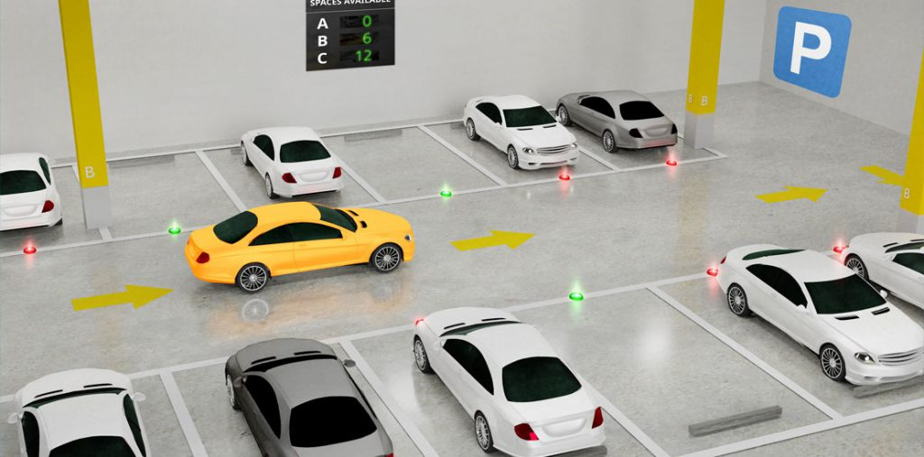
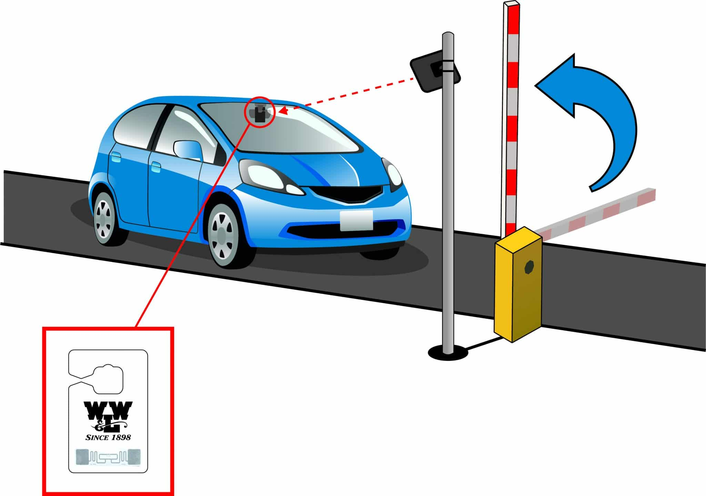
4. Solution
Automated vehicle access control system using RFID and IOT

Slide 6
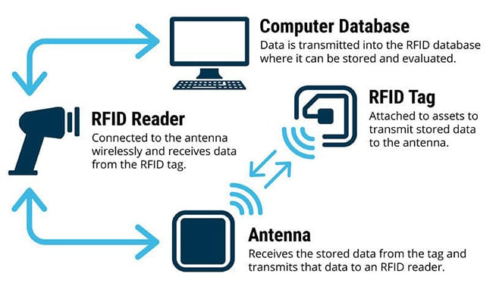
What is RFID and how does it work?

Slide 7
System description
Automated vehicle access control system using
RFID and IoT
Entry system
Exit system
Parking slots monitoring
Consists of RFID reader and a servomotor connected to a microcontroller (PIC16F877A)
Consits of an Ultrasonic sensor and a servomotor connected to a microcontroller (Arduino UNO)
Consists of Infrared sensors connected to a WIFI red using ESP32

Slide 8
How does our system work?
2.Activate barricade secuence
If the RFID tag matchs with any RFID code in the database, the barricade will be open for a short time and then it will close automatically.
1. Entry System (RFID reader)
RFID Reader scans the RFID tags and compare ID’s with de database ID’s
3.Parking slots status
The IR sensors detect if a car is occupying a slot.
5. Exit System (Ultrasonic)
4.Web page
If the ultrasonic sensor detects a car approaching, the exit barricade’s sequence will be activated
The web page displays a graphic with the slots and will indicate if the slot is available or not

Slide 9
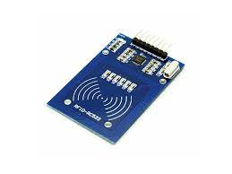
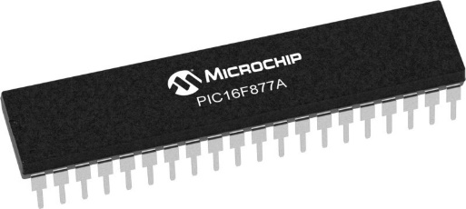
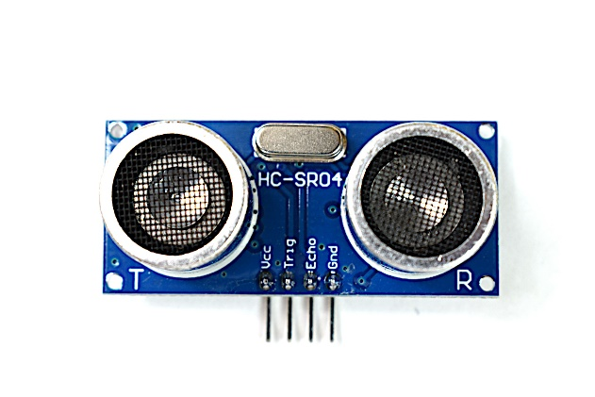
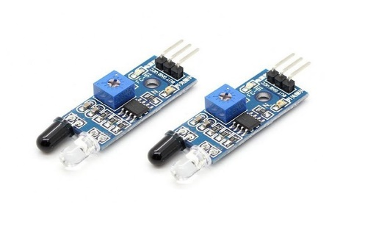
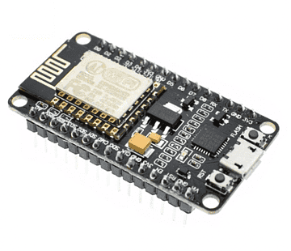
5.Results
Entry System
-PIC 16F877A -RFID Reader -RFID Tags -Servomotor
-LCD 16x2
HARDWARE
Exit System
-Ultrasonic sensor -Arduino UNO -Servomotor
Parking slot monitoring
-IR sensor -ESP32

Slide 10
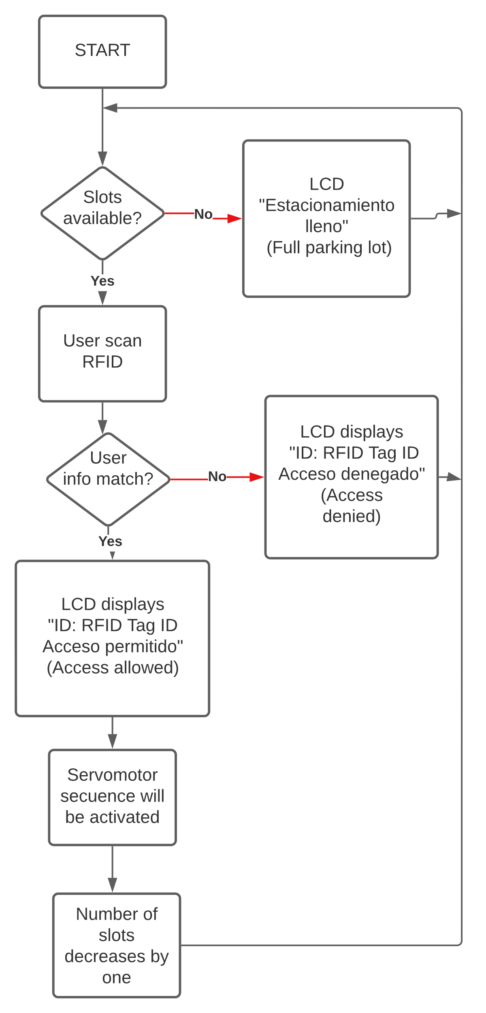
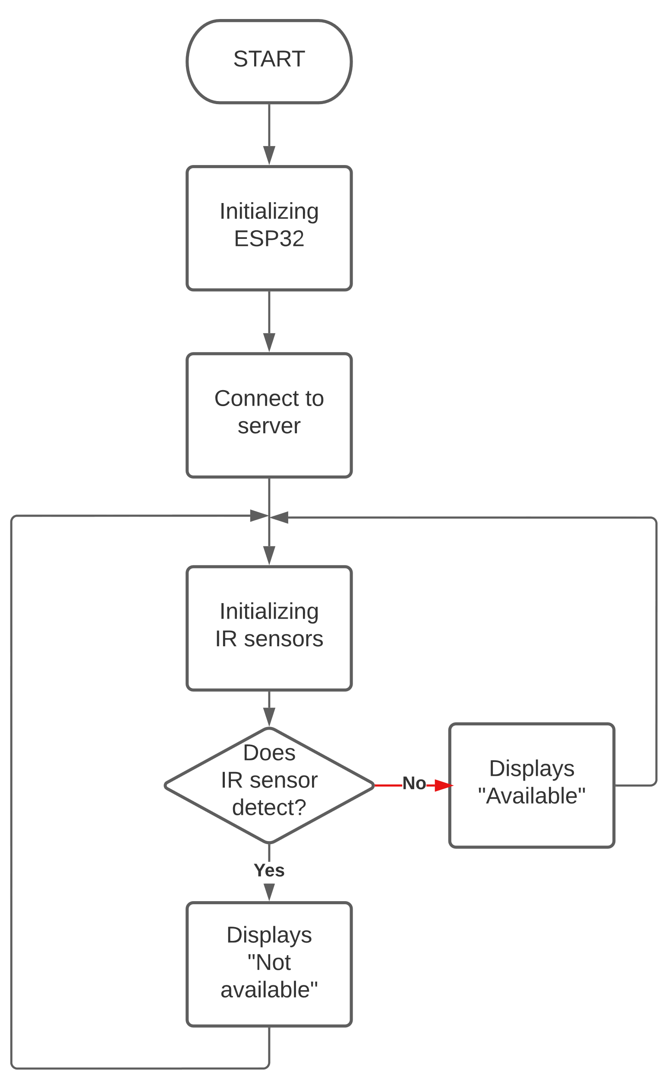
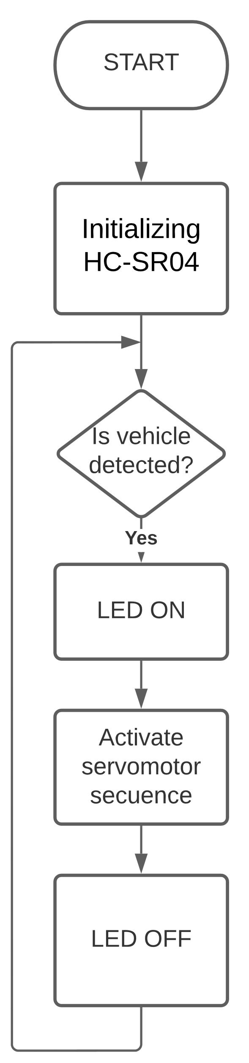
Flow charts

Slide 11
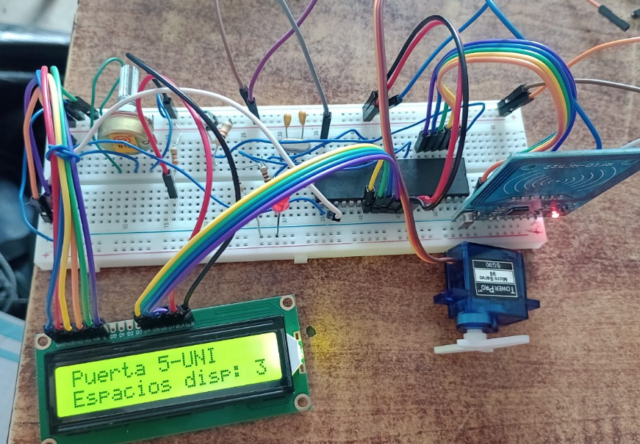
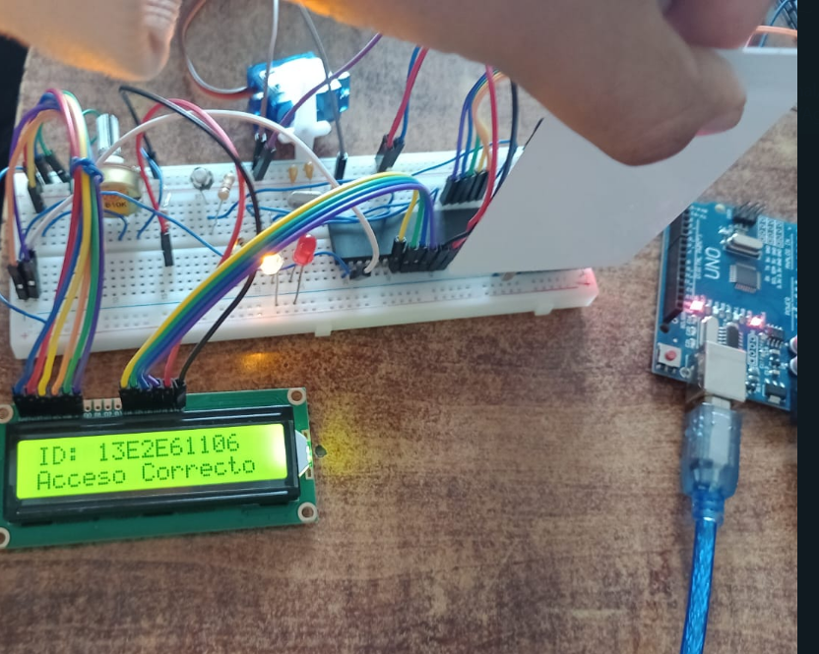
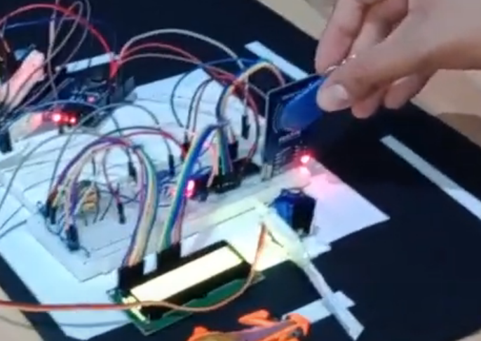
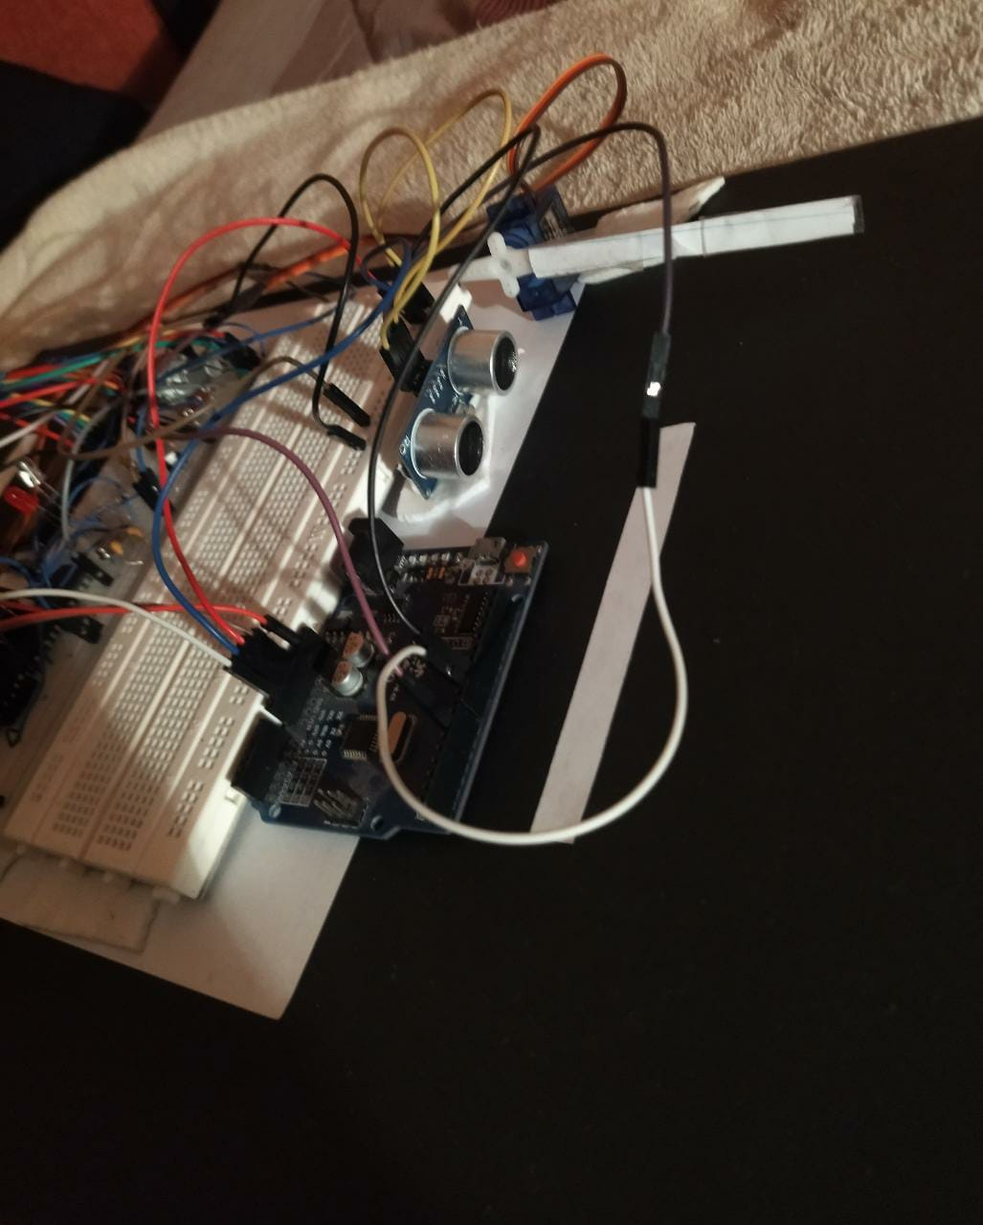
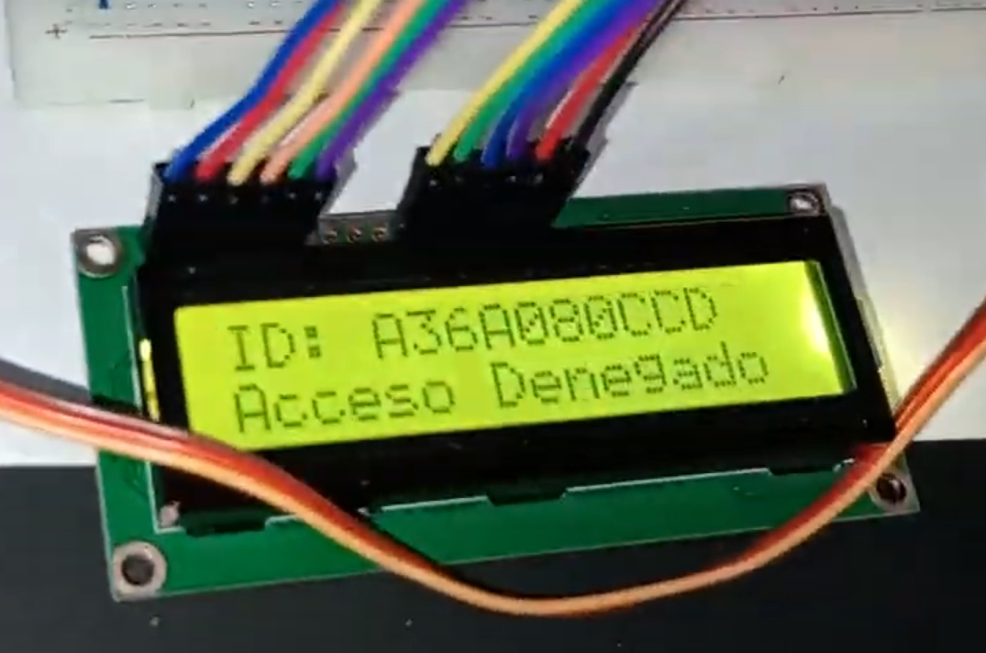
Entry/Exit system
Entry system is activated
If RFID tag is accepted
If RFID tag is rejected
Exit system is activated
Entry system is turn on. LCD shows number of the slots
LCD displays “Acceso correcto” and the servomotor sequence is activated
LCD displays “Acceso denegado” and the red LED is turn on
Servomotor’s exit sequence will be activated if the ultrasonic

Slide 12
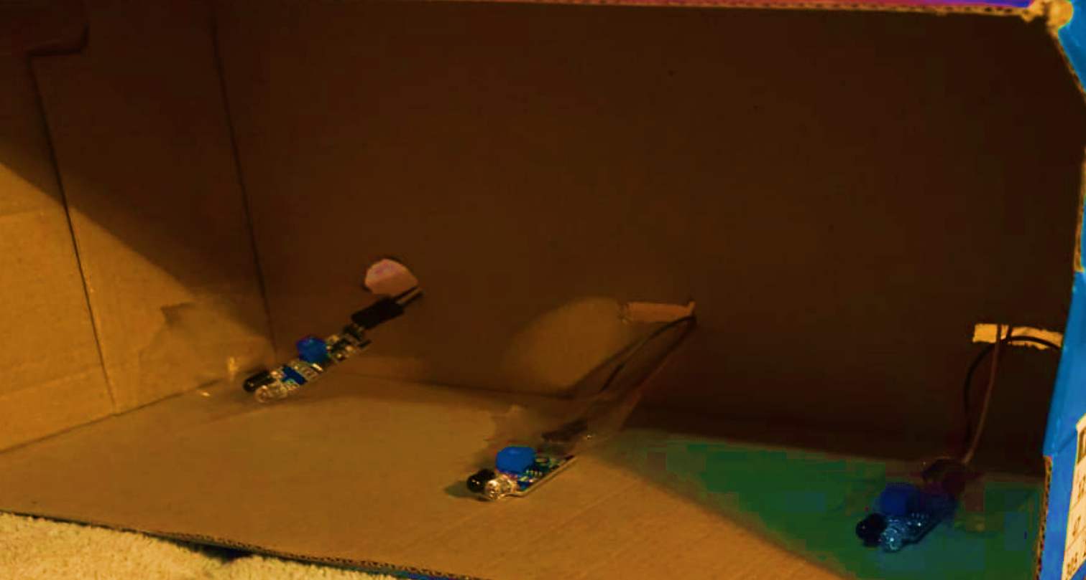
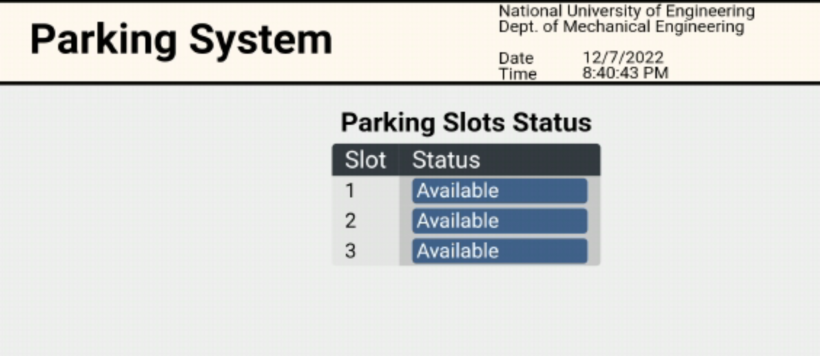
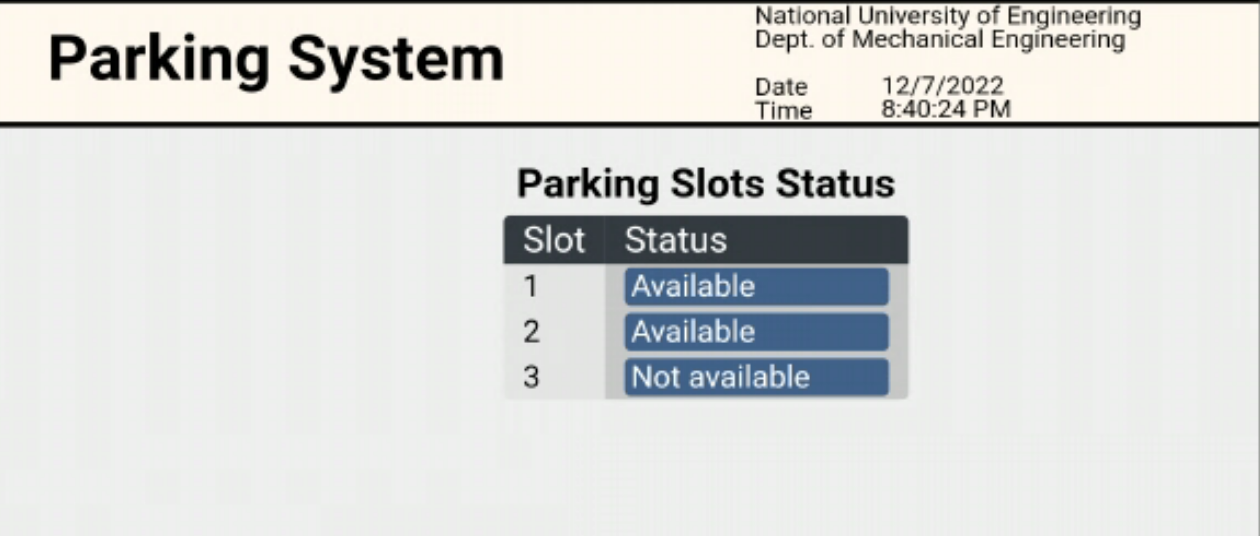
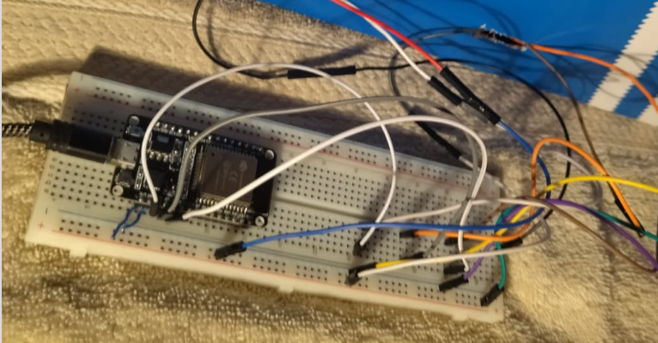
Parking slots monitoring system
Monitoring system is activated
Web Page
IR sensors are activated ESP32 host locally the web page
Web page shows if the slots are available or not available

Slide 13

6. Conclusions
The great advancement of IoT and Cloud Technologies helped the growth of smart cities applications and implementation.
The entry/exit system will help avoiding wasting time at the entry and exit terminals and increase the security in the parking area by granting the access only for the authorized commuters
The second system help informing about the available
parking spots to the user through the website, avoiding wasting
time looking for one.

Slide 14
7. Possible upgrades
Vehicle validation can be done by machine learning and computer vision algorithms e.g. ANPR (Automated number plate recognizing).
Web page could show a map with the parking slots to make easier the car parking and avoiding wasting of time.

